Slide 1
Toronto Healthy Food - Juice Bar
The Battle of the Neighborhoods
Α capstone project for IBM Data Science Professional Certificate
By Gregory Tampasis

Slide 2

Business Problem
looking for an optimal location to open a healthy food / fruit bar.
@ Toronto

Slide 3
Methodology
In this project, we are going to look for an optimal location to open a healthy food / fruit bar. Specifically, this report can provide a reference for stakeholders who are interested in opening a healthy / fruit bar based on places that gather people / potential customers (cyclists, athletes, people that go to the gym etc) at Toronto.
In this report, we will focus on all areas of Toronto analyzing
Areas that can have potential customers
Areas that already have similar business
We will analyze data and use a clustering model in order to find best mathing areas and where exist similar business
Then we will use deferent approaches using simple mean values and K-means analysis based on
number of target shops
capacity of places that gather targeted customers
We will use data science tools to fetch the raw data, visualize it then generate a few most promising areas based on the above criteria.

Slide 4
DAta
The data sets used are relevant to the targeted customer habits described, like bicycle parking spaces, athletes' shops etc.
More data can be added. The analysis and Python methods that used are
- Folium library
- Foursquare APIs
- mean methodology
- K-Means Clustering Algorithm
- Horizontal Bar Chart
- Pandas, Numpy, Shapely

Slide 5
Data
Based on the definition of our problem, factors that may impact our decision are:
Demographic information, e.g. population
Number of existing healthy food and Juice bars in the neighborhood and nearby
Number of existing shops gyms and places that might potential customers might be interested

Slide 6
Toronto area
 | POSTAL_CODE | Latitude | Longitude
0 | M1B | 43.806686 | -79.194353
1 | M1C | 43.784535 | -79.160497
2 | M1E | 43.763573 | -79.188711
3 | M1G | 43.770992 | -79.216917
4 | M1H | 43.773136 | -79.239476
... | ... | ... | ...
98 | M9N | 43.706876 | -79.518188
99 | M9P | 43.696319 | -79.532242
100 | M9R | 43.688905 | -79.554724
101 | M9V | 43.739416 | -79.588437
102 | M9W | 43.706748 | -79.594054
lat_lng_df=pd.read_csv('http://cocl.us/Geospatial_data')

Slide 7

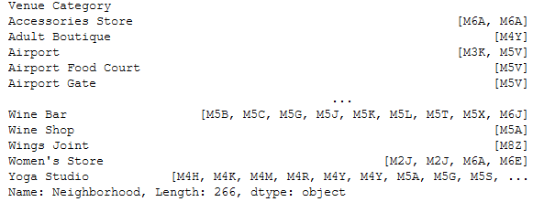
Data selection
https://foursquare.com
venues.groupby('Venue Category')['Neighborhood’]
points of interest
Swim School | Stadium | Spa Gym | Gym / Fitness Center |Baseball | Baseball | Athletics
points to avoid
Salad Place | Smoothie Shop | Organic Grocery | Juice Bar

Slide 8

Data selection
_id
ADDRESS_POINT_ID
ADDRESS_NUMBER
LINEAR_NAME_FULL
ADDRESS_FULL
POSTAL_CODE MUNICIPALITY
CITY
CENTRELINE_ID
LO_NUM
LO_NUM_SUF
HI_NUM HI_NUM_SUF
LINEAR_NAME_ID WARD_NAME
X
Y
LONGITUDE
LATITUDE
MI_PRINX
OBJECTID
CAPACITY
MULTIMODAL
SEASONAL
SHELTERED
SURFACE
STATUS
LOCATION
NOTES
MAP_CLASS
geometry
https://open.toronto.ca/
Street Furniture - Bicycle Parking
Bicycle Parking - Bike Stations (Indoor)
Bicycle Shops

Slide 9
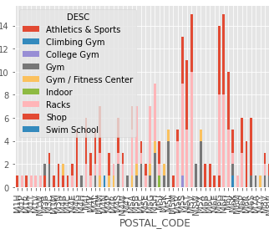
visualizing data
import matplotlib.pyplot as plt
plt.style.use('ggplot')
all_poi.groupby(['POSTAL_CODE','DESC']).size().unstack().plot(kind='bar',stacked=True)
plt.show()

Slide 10
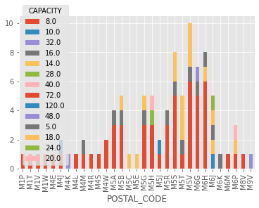
visualizing data
all_poi.groupby(['POSTAL_CODE','CAPACITY']).size().unstack().plot(kind='bar',stacked=True)
plt.show()

Slide 11
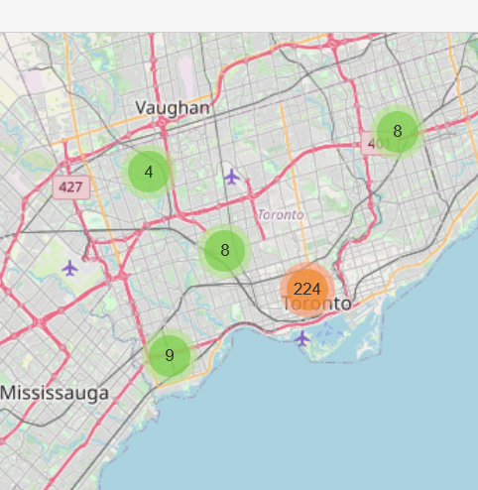
Mapping DATA
from folium import plugins
for lat, lng, label, in zip(all_poi.Latitude, all_poi.Longitude, all_poi.DESC):
folium.Marker(
location=[lat, lng],
icon=None,
popup=label,
).add_to(incidents)

Slide 12
Numerical Analysis
 | POSTAL_CODE | DESC | CAPACITY | Latitude | Longitude
0 | M5J | 4 | 192.0 | 43.640816 | -79.381752
1 | M5V | 15 | 106.0 | 43.628947 | -79.394420
2 | M6G | 14 | 104.0 | 43.669542 | -79.422564
3 | M5H | 9 | 92.0 | 43.650571 | -79.384568
4 | M5S | 13 | 84.0 | 43.662696 | -79.400049
5 | M6J | 10 | 71.0 | 43.647927 | -79.419750
6 | M6H | 15 | 67.0 | 43.669005 | -79.442259
7 | M5T | 11 | 66.0 | 43.653206 | -79.400049
8 | M5G | 7 | 54.0 | 43.657952 | -79.387383
9 | M5B | 7 | 54.0 | 43.657162 | -79.378937
10 | M6P | 6 | 42.0 | 43.661608 | -79.464763
11 | M5A | 7 | 40.0 | 43.654260 | -79.360636
12 | M5R | 5 | 40.0 | 43.672710 | -79.405678
13 | M4M | 7 | 24.0 | 43.659526 | -79.340923

Slide 13
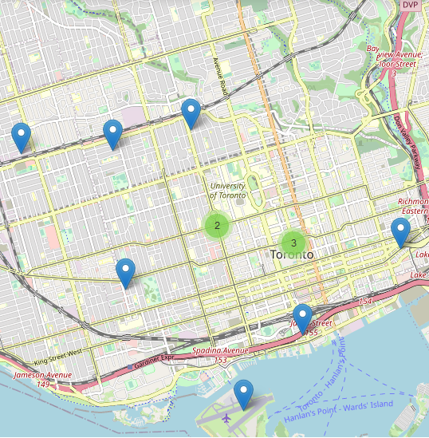
Numerical Analysis
Count points of interest per Postal code
Calculate capacity per Postal Code
my_places mean is 3
my_cap mean is 20
Top postal codes over mean values
14 Postal codes / ideal places.

Slide 14
k - means Analysis points of Interest
POSTAL_CODE | 1st Most Common Venue | 2nd Most Common Venue | 3rd Most Common Venue | 4th Most Common Venue | 5th Most Common Venue | 6th Most Common Venue
M1H | Athletics & Sports | Swim School | Shop | Racks | Indoor | Gym / Fitness Center
M1P | Racks | Swim School | Shop | Indoor | Gym / Fitness Center | Gym
M1R | Shop | Swim School | Racks | Indoor | Gym / Fitness Center | Gym
M1T | Racks | Swim School | Shop | Indoor | Gym / Fitness Center | Gym
M1V | Racks | Swim School | Shop | Indoor | Gym / Fitness Center | Gym
M1W | Racks | Swim School | Shop | Indoor | Gym / Fitness Center | Gym
M3B | Gym | Athletics & Sports | Swim School | Shop | Racks | Indoor
M3C | Gym | Shop | Swim School | Racks | Indoor | Gym / Fitness Center
M3M | Shop | Swim School | Racks | Indoor | Gym / Fitness Center | Gym
M3N | Shop | Athletics & Sports | Swim School | Racks | Indoor | Gym / Fitness Center
M4B | Gym / Fitness Center | Athletics & Sports | Swim School | Shop | Racks | Indoor
M4C | Athletics & Sports | Swim School | Shop | Racks | Indoor | Gym / Fitness Center
M4E | Shop | Racks | Swim School | Indoor | Gym / Fitness Center | Gym
M4G | Shop | Swim School | Racks | Indoor | Gym / Fitness Center | Gym
M4H | Gym | Swim School | Shop | Racks | Indoor | Gym / Fitness Center
M4J | Shop | Racks | Swim School | Indoor | Gym / Fitness Center | Gym
num_top_venues = 6
kclusters = 10

Slide 15
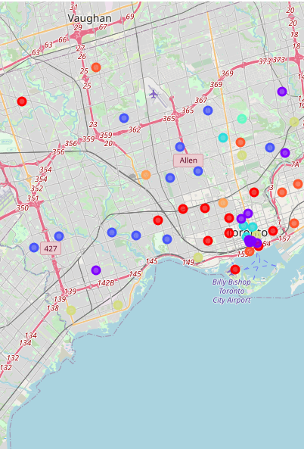
k - means Analysis points of Interest
The table and map analyzes the top 10 venues in each postal code is very interesting because it will tell us the trends of each neighborhood.
toronto_merged.loc[toronto_merged['Cluster Labels'] == 0 or 1 or 2 or 3 …. , toronto_merged.columns[[0] + list(range(11, toronto_merged.shape[1]))]]
Can see the details @ notebook

Slide 16
k - means Analysis Capacity
 | POSTAL_CODE | CAPACITY | Cluster Labels | 1st Most Common Venue | 2nd Most Common Venue
18 | M4M | 12.0 | 0 | CAPACITY | CAPACITY
26 | M5A | 10.0 | 0 | CAPACITY | CAPACITY
27 | M5B | 10.8 | 0 | CAPACITY | CAPACITY
30 | M5G | 10.8 | 0 | CAPACITY | CAPACITY
36 | M5R | 10.0 | 0 | CAPACITY | CAPACITY
37 | M5S | 10.5 | 0 | CAPACITY | CAPACITY
39 | M5V | 10.6 | 0 | CAPACITY | CAPACITY
num_top_venues = 2
kclusters = 5
e.g. for cluster = 0

Slide 17
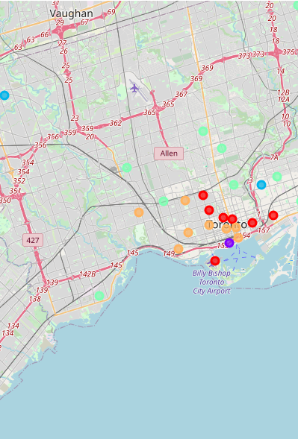
k - means Analysis Capacity
The table and map analyzes the capacity = crowd gathering in each postal code is very interesting because it will tell us the trends of each neighborhood.
toronto_merged.loc[toronto_merged['Cluster Labels'] == 0 or 1 or 2 or 3 …. , toronto_merged.columns[[0] + list(range(11, toronto_merged.shape[1]))]]
Can see the details @ notebook

Slide 18
Analysis
K-means / clusters – Capacity : can see that cluster = 0 or 4 are located closely and have in total a high capacity which is translated to more people.
K-means / clusters – DESC (poi) : can see that cluster = 1,2,4 places are located close to our points of our Capacity analysis and also have a variety of venues that are popular to our potential customers.
We can merge the results in order to find the common Postal codes
mergedStuff = pd.merge(to_1, to_2, on=['POSTAL_CODE'], how='inner’)
Cluster Labels = 1 or 4
Cluster Labels = 1 or 2 or 4
e.g.
 | POSTAL_CODE | Cluster Labels_x | Cluster Labels_y
0 | M5H | 1 | 4

Slide 19
ANALYSIS
Clusters Capacity | Clusters POI | Postal Codes
0 | 1 | M5B M5G M5R
0 | 2 | 0
0 | 4 | M4M M5A M5S M5V
4 | 1 | M5H
4 | 2 | 0
4 | 4 | M5E M5T M6G M6J M6P
Try combinations in order to evaluate the results.
Select best options based on other criteria
e.g. City location, population etc.

Slide 20
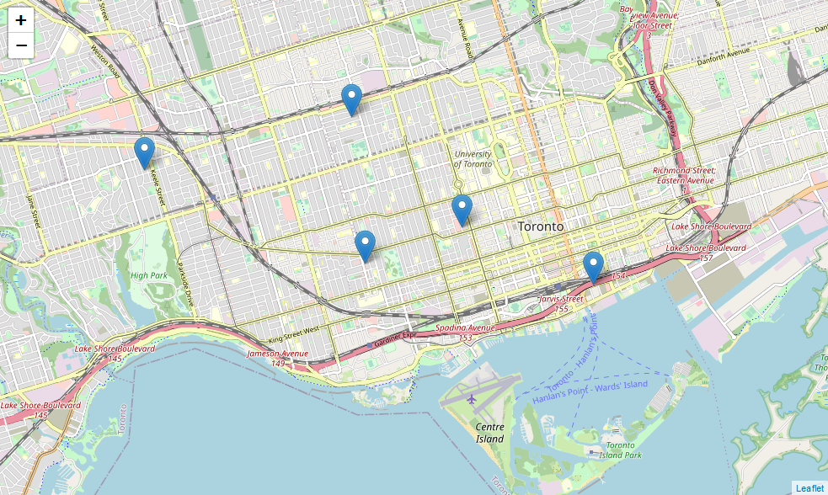
Result
Clusters Capacity | Clusters POI | Postal Codes
4 | 4 | M5E M5T M6G M6J M6P

Slide 21
Further ANALYSIS
Use Avoid Post codes list
Confirms that our out put is correct since there already similar places exist
The fact that @ our final post code locations Juice bars exist doesn’t mean that another one can open as well.
 | POSTAL_CODE | Cluster Labels_x | Cluster Labels_y
0 | M5H | 1 | 4

Slide 22
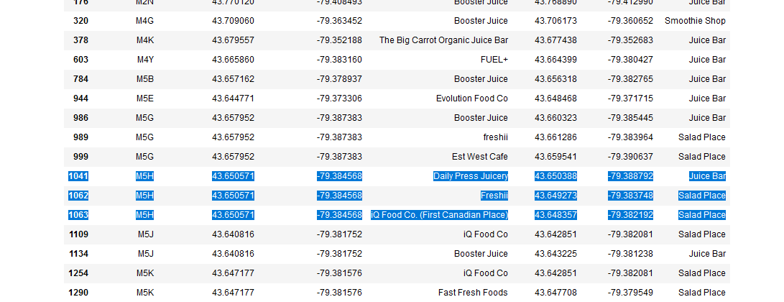
Further ANALYSIS
@ M5H poste code area we already have 3 existing places that offer similar services

Slide 23
Further ANALYSIS
Avoid completion
exclude Post code from Avoid list
Set more criteria
The fact that @ our final post code locations Juice bars exist doesn’t mean that another one can open as well.
Μore data
Population
Add more data
Foursquare rating
Add weight on data criteria
Discussion

